Slide 1
Regenerating soil using improved flood irrigation
使用改进的大水漫灌的再生土壤

Slide 2
Preface
Thirty years ago there were some 2 billion people, largely in America and Europe living an industrial life style and putting pressure on the environment. There were some 3 billion people in developing countries living essentially a peasant existence and providing environment services to the rich nations.
The industrialisation of the developing world has increased the number of people living an industrial life style from 2 billion to 5 billion people while the number living a peasant existence has dropped to 2 billion.
In the next thirty years we can expect that the number of people living an industrial life style will rise to 8 billion with only a billion living a peasant life style. That is the astonishing figure of a fourfold increase in environmental pressure in a generation.
30年前，有大约2亿人，主要集中在美国和欧洲，生活工业的生活方式，并把对环境的压力。共有约3亿人在发展中国家生活本质上是一个农民的生存和提供环境服务，以丰富的国家。发展中国家的工业化已经从2亿至5亿人生活的一个工业的生活方式的人的数量增加，而居住的农民存在的数量已下降到2亿美元。我们可以预计在未来30年只有一亿美元的生活，工业的生活方式生活的人的数量将上升至8亿农民的生活方式。这是惊人的数字，在一代中的环境压力的增加了四倍。

Slide 3
We know that the green revolution, basically genetics, irrigation and fertilisers has given us a temporary surplus of food. However we can see a destruction of the soil biology which reduces the capacity of the soil to regenerate and be able to recycle nutrients. We are essentially mining our soil in a non-sustainable way.
Here I want to explain a sustainable system of improving soil quality with the potential of recycling waste.
我们知道，绿色革命，基本上遗传学，灌溉和肥料，给我们的食品的临时盈余。然而，我们可以看到土壤生物的破坏，从而降低了土壤的再生能力，并能够回收养分。我们基本上是在一个不可持续的方式挖掘我们的土壤。 在这里，我想解释的废物回收的潜力土壤质量的改善与可持续系统。

Slide 4
Synopsis
I will show a system where conventional furrow irrigation channels can be sealed using native plant leaves to prevent water soaking into the subsoil. The furrows can be and filled with organic material to hold large quantities of water and encourage soil biology to improve soil quality.
我将展示一个系统，可以使用原生植物叶片，以防止水浸泡的地基被封闭在常规沟灌渠道。犁沟和持有大量的水和鼓励改善土壤质量，土壤生物与有机材料填充。

Slide 5
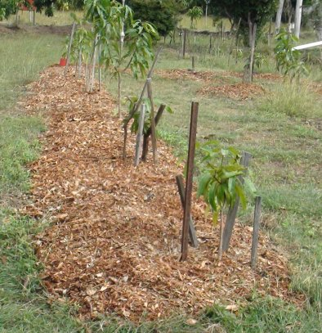
Sloping furrow filled with wood chips
用木屑填充坡沟

Slide 6
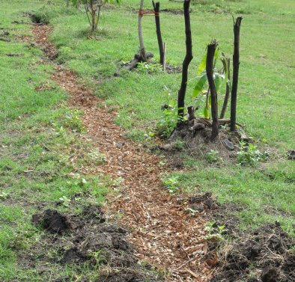
Wood chips have rotted down to form a spoon drain
木片已腐烂，形成一个勺子漏

Slide 7
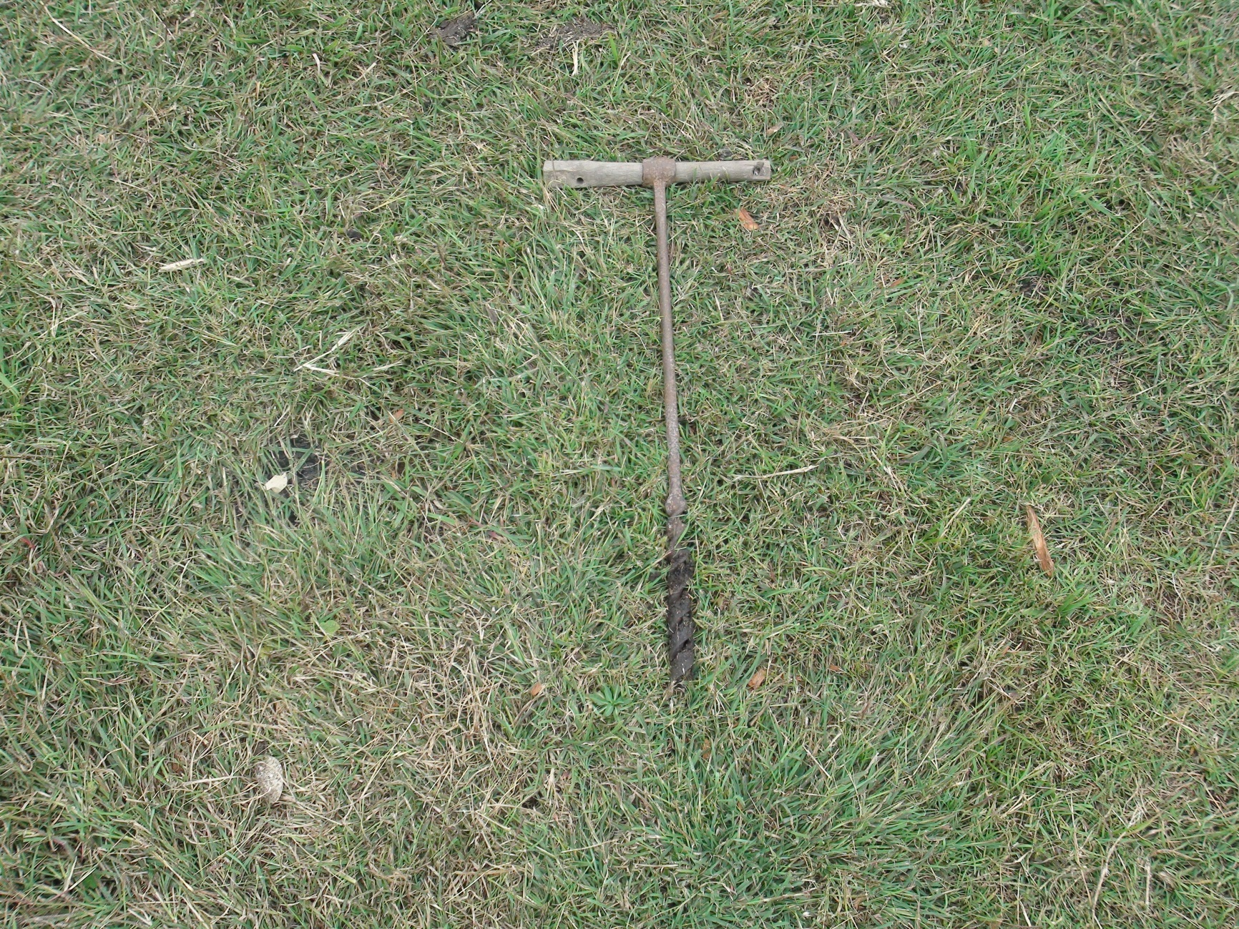
The traditional auger is used for testing the wetted area
传统的螺旋用于测试的沾湿面积

Slide 8
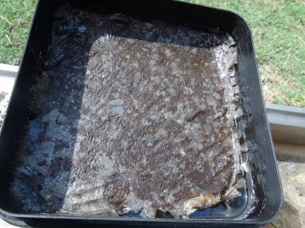
Wax film formed from gum leaves seals the soil
从胶形成的蜡膜叶密封土壤

Slide 9
Leakage from irrigation raises the water table bringing salt with it killing off vegetation
从灌溉渗漏，提高地下水位，杀死植被带盐

Slide 10
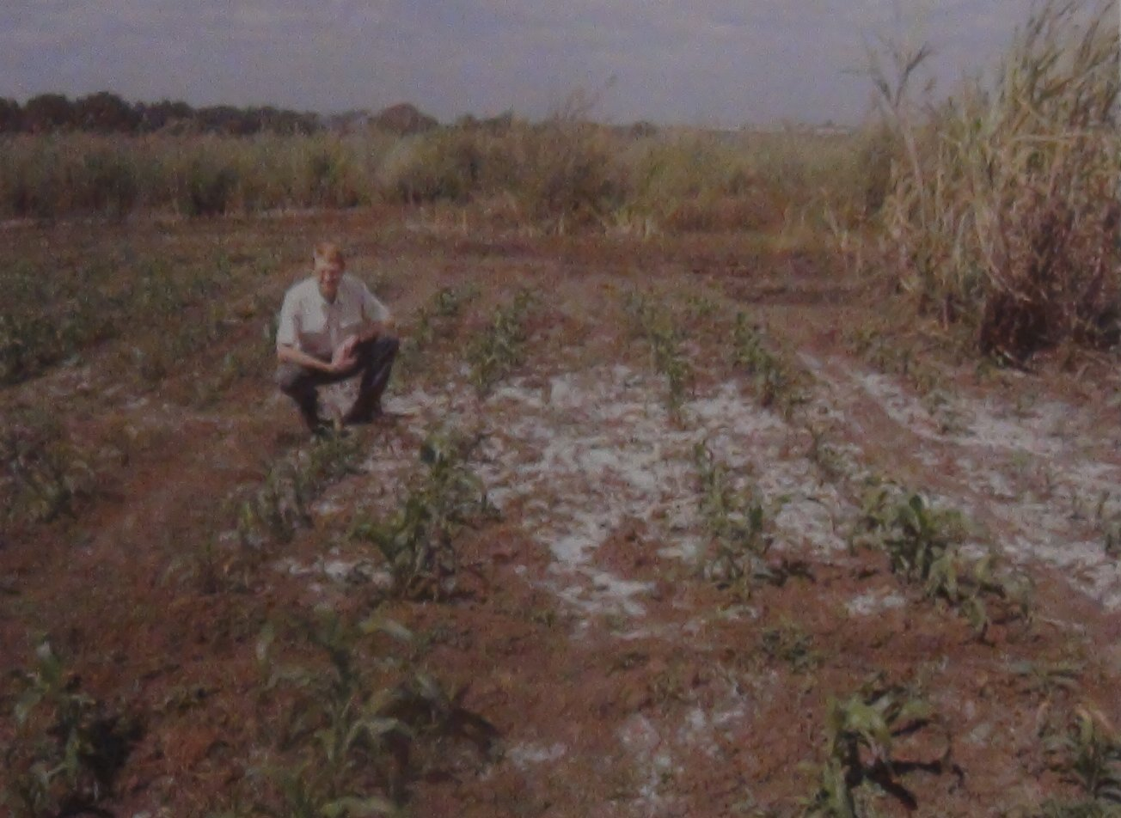
Salinity caused by rising water table from irrigation
由灌区地下水位上升造成的盐度

Slide 11
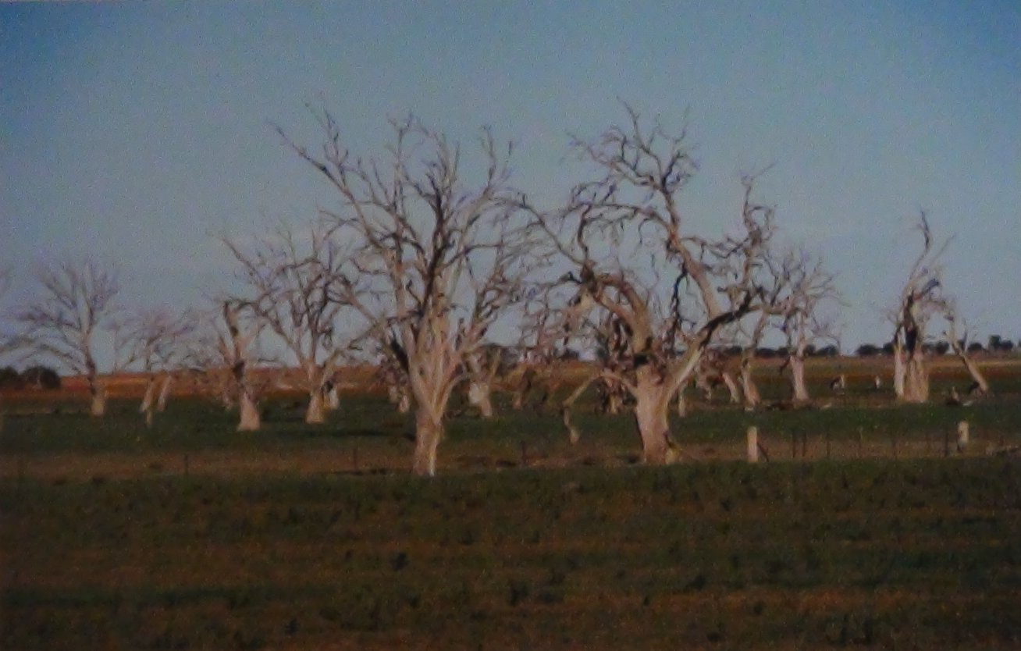
Australia has huge areas of dead trees that lost the battle in lowering the water table.
澳大利亚拥有巨大的枯树，失去了战斗在降低地下水位领域。

Slide 12
Almost 40 years ago Australia suffered immense dust storm loosing millions of tonnes of top soil. I decided to investigate how to regenerate soil and found keeping the soil moist, not too wet, not too dry was critical
近40年前，澳大利亚遭受了巨大的沙尘暴，损失数百万​​吨表层土壤。我决定探讨如何再生土壤，保持土壤湿润，不要太湿，不能太干是关键

Slide 13
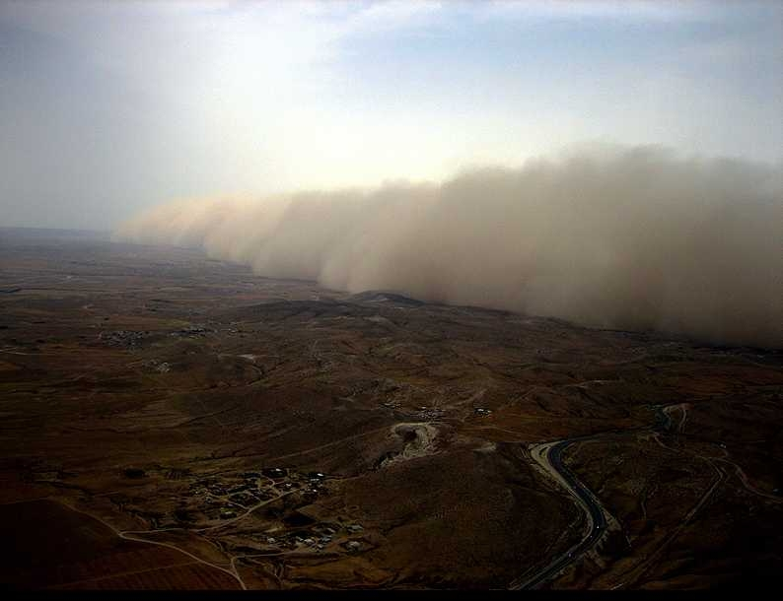
Massive dust storms from degraded land
退化土地的大规模沙尘暴

Slide 14
Moist conditions encourage soil biology, particularly fungi. See how the grass is growing faster in the centre of this fungal circle
潮湿的条件下，鼓励土壤生物学，特别是真菌。草长如何在这种真菌圈的中心快

Slide 15
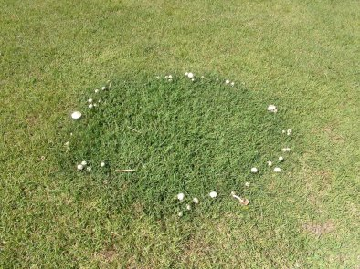
Fungi ring 真菌环

Slide 16
With the help of Australian Government funding I developed a highly sophisticated sensor based computer control irrigation system
与澳大利亚政府资金的帮助下，我开发了一个高度复杂的传感器基于计算机控制的灌溉系统

Slide 17
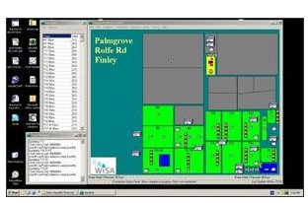
Computer controlled irrigation system
计算机控制的灌溉系统

Slide 18
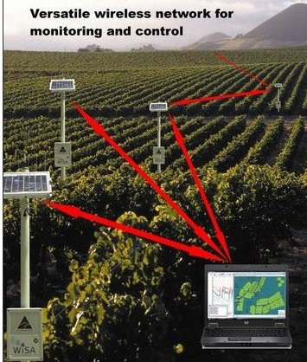
Solar powered radio systems turns valve on and off based on soil moisture readings
太阳能供电的无线电系统打开阀门开启和关闭基于对土壤水分读数

Slide 19
this was technically successful and was adopted by a few leading edge farmers growing high value crops but the system was to complicated for the typical rural farmer.
Lesson - solutions must be farmer friendly
这在技术上是成功的，并通过了几个领先优势，农民种植高价值作物，但该系统是典型的农村农民的复杂。 ？课 - 解决方案必须是有利于农民

Slide 20
A totally new approach was needed. The wicking bed has a reservoir of water under the roots which maintain the soil moist. This is a very simple system widely adopted in urban agriculture
一种全新的方法是必要的。排汗床，下水库的水，保持土壤湿润的根。这是一个非常简单的系统，在都市农业广泛采用

Slide 21
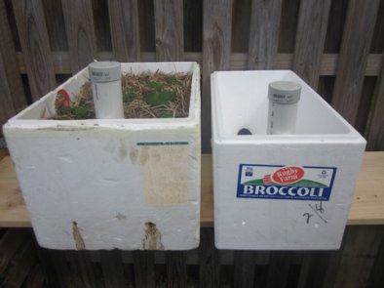
Scrap vegetable boxes can be converted to wicking beds by punching a few holes in the side and using a pipe to direct water to the base
废钢蔬菜箱，可转换为排汗床冲压侧了几个洞，并使用管道水直接到基地

Slide 22
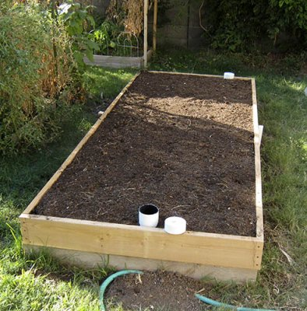
Many different types of wicking boxes have been used successfully, sidewalls to contain the soil are preferred.
已成功地应用于许多不同类型的吸湿盒，包含土壤的侧壁是首选。

Slide 23
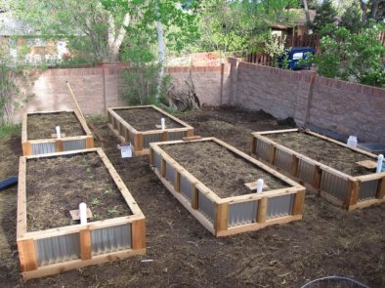

Slide 24
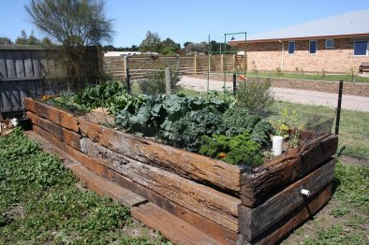

Slide 25
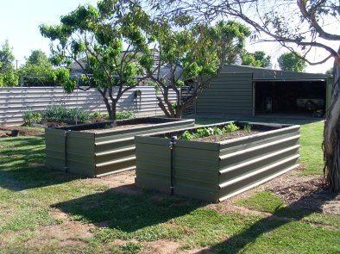

Slide 27
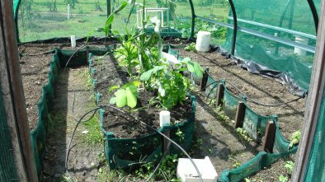
Shade cloth provides very effective drainage, but weeds can be a problem
遮光布提供了非常有效的排水系统，但杂草可能是一个问题

Slide 28
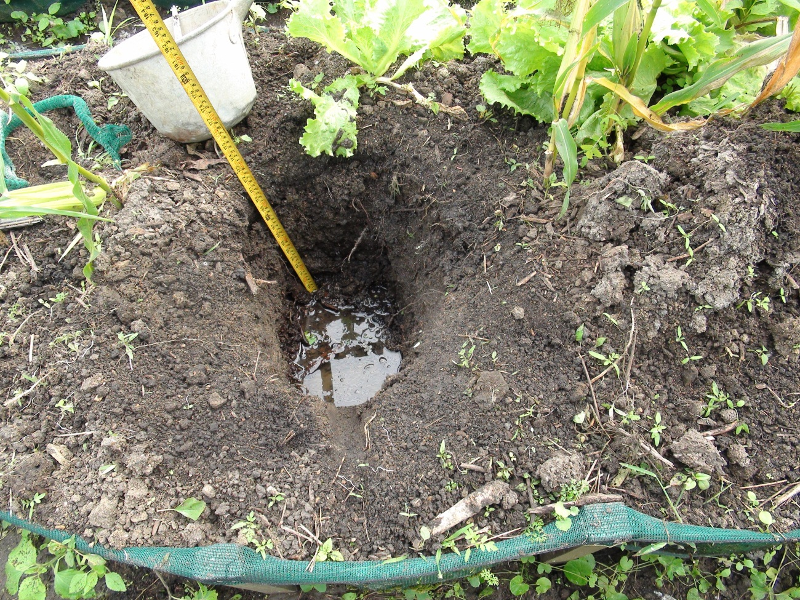
Subsurface water table must give adequate depth for roots
地下水表必须给予足够的深度为根

Slide 29
Wicking boxes are very successful for small scale application. Another technique is needed for large scales use.
This can be achieved by using a spoon drain, lining with plastics and filling with organic material so the water can wick upwards then sideways.
排汗箱小规模的应用是非常成功的。另一种方法需要使用大尺度。可以做到这一点，用勺子漏，塑料衬里和填充有机物质，使水可以向上灯芯然后侧身。

Slide 30
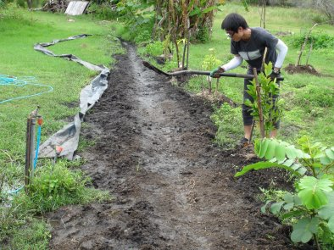
Spoon drain
勺漏

Slide 31
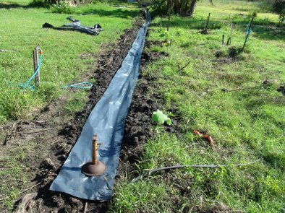
Lined with plastic to prevent downwards leakage
用塑料内衬，以防止向下泄漏

Slide 32
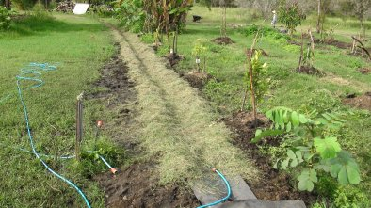
Filled with organic material to act as a wick and allow water to move sideways
与有机材料填充作为灯芯，让水侧身移动

Slide 33
Using a plastics film is very efficient for water use, but there is a feeling that farmers will not like using such large areas of plastics. Alternatives to the plastics film were investigated.
The first trial was with compaction but this was only marginally successful. The clay soil used would form deep cracks when it dried out causing major water losses and when wet for a long period of time it would form a slurry.
使用塑料薄膜是很水的利用效率，但有一种感觉，农民不喜欢使用塑料等大面积。塑料薄膜的替代品进行了调查。一审压实，但只是勉强成功。所用的粘土形成深裂时，造成重大水的损失和湿了很长一段时间，它会形成泥浆干涸。

Slide 34
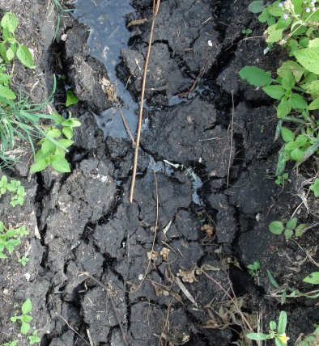
On drying deep crack form allowing the water to leak deep into the soil
深裂的形式，让水渗入土壤深层干燥

Slide 35
Another method was needed. It was remembered that Fraser Island is made of pure sand but has lakes and streams which are sealed by gum leaves.
另一种方法是必要的。有人想起弗雷泽岛是由纯沙，但有湖泊和密封胶叶流。

Slide 36
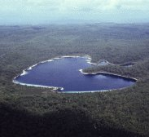
Fraser island is pure sand but has large lakes as the sand is sealed by leaves
弗雷泽岛是纯沙，但有大型湖泊为沙叶密封

Slide 37
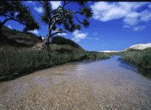
Fraser Island stream
弗雷泽岛流

Slide 38
I mixed some eucalyptus cream with sand and put into a filter. When I filled it with water it showed an almost perfect seal. When I tried this with eucalyptus oil the water ran straight through.
This indicated that it was wax that was sealing the soil.
我混合一些沙桉树的奶油和投入一个过滤器。当我装满了水，它表明一个近乎完美的密封。当我试着用桉树油，水直通运行。？这表明它是蜡密封的土壤 。

Slide 39
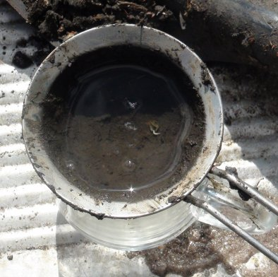
Sand mixed with eucalyptus cream gave an almost perfect seal
沙与桉树霜混合了近乎完美的密封

Slide 40
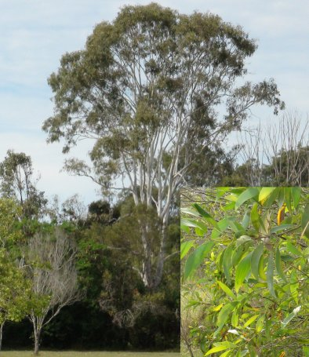
Eucalyptus tree 桉树

Slide 41
To experiment further I took a bucket with holes in the base, filled with clay. Just putting gum leaves onto the soil made no difference, the water just flowed straight through.
I then mechanically mixed the leaves into the soil. This formed an almost perfect seal. A wax film formed on the surface of the water although probably most of the wax was in the soil.
进一步的实验，我把与基地中的漏洞的水桶，用粘土填充。只是把土壤上的口香糖叶水没有什么区别，只是流过直通。然后，我机械地混合到土壤中的叶子。这形成了一个近乎完美的密封。一个蜡膜形成的水面上，虽然可能大多数的蜡在土壤中。

Slide 42
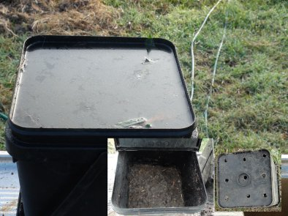
Test bucket with holes in base
基孔试验桶

Slide 43
Wax film formed from gum leaves seals the soil
从胶形成的蜡膜叶密封土壤

Slide 44
I have now dug a series of holes and am experimenting with different types of leaves and processes to bind the leaves into the soil. Unfortunately it takes times for decomposition to work so we just have to wait.
我现在已经挖了一个洞，我尝试不同类型的叶子和流程绑定到土壤中的树叶。不幸的是，它需要分解的时候工作，所以我们只能等待

Slide 45
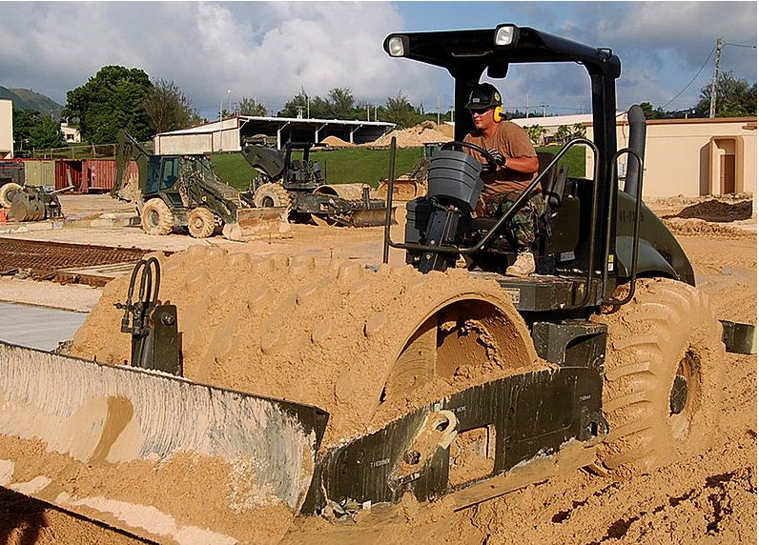
A miniature version of the boot roller may be suitable for compacting the leaves.
引导辊的一个微型版本，可能是适合密实的树叶

Slide 46
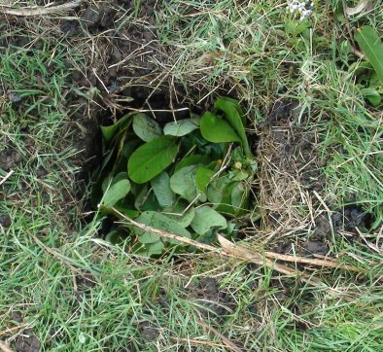
Test hole
测试孔

Slide 47
Green waste can be collected however the large volume of material means that growing on farm is needed. Strips of soil plants can be grown in rows, there is a short term cost but this is likely to be more than offset by improved production from better soil. My preferred plant is sena alatus. Strip farming is now well established in Australia using a variety of plants and is proving economic.
然而大量的材料意味着对农业增长的需要，可以收集绿色废物。土壤植物带可以种植行中，有一个短期的成本，但是这很可能是多更好的土壤改良生产抵消。我的首选植物，是塞纳箭羽。地带耕作在澳大利亚建立了使用多种植物，并证明经济。

Slide 48
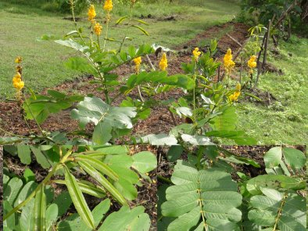
SENA ALATUS

Slide 49
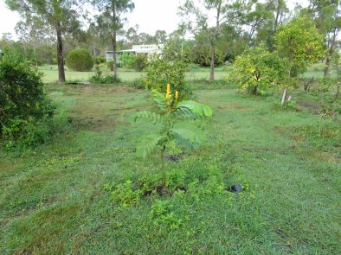

Slide 50
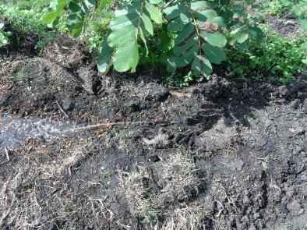

Slide 51
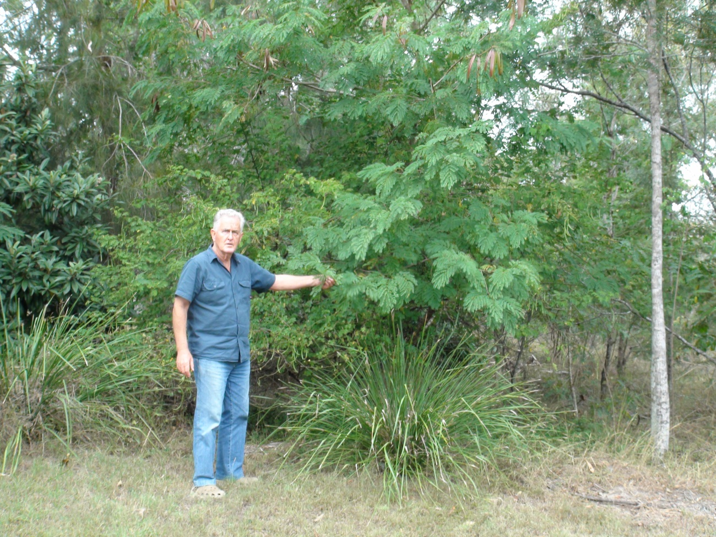
www.leucaena.net

Slide 52
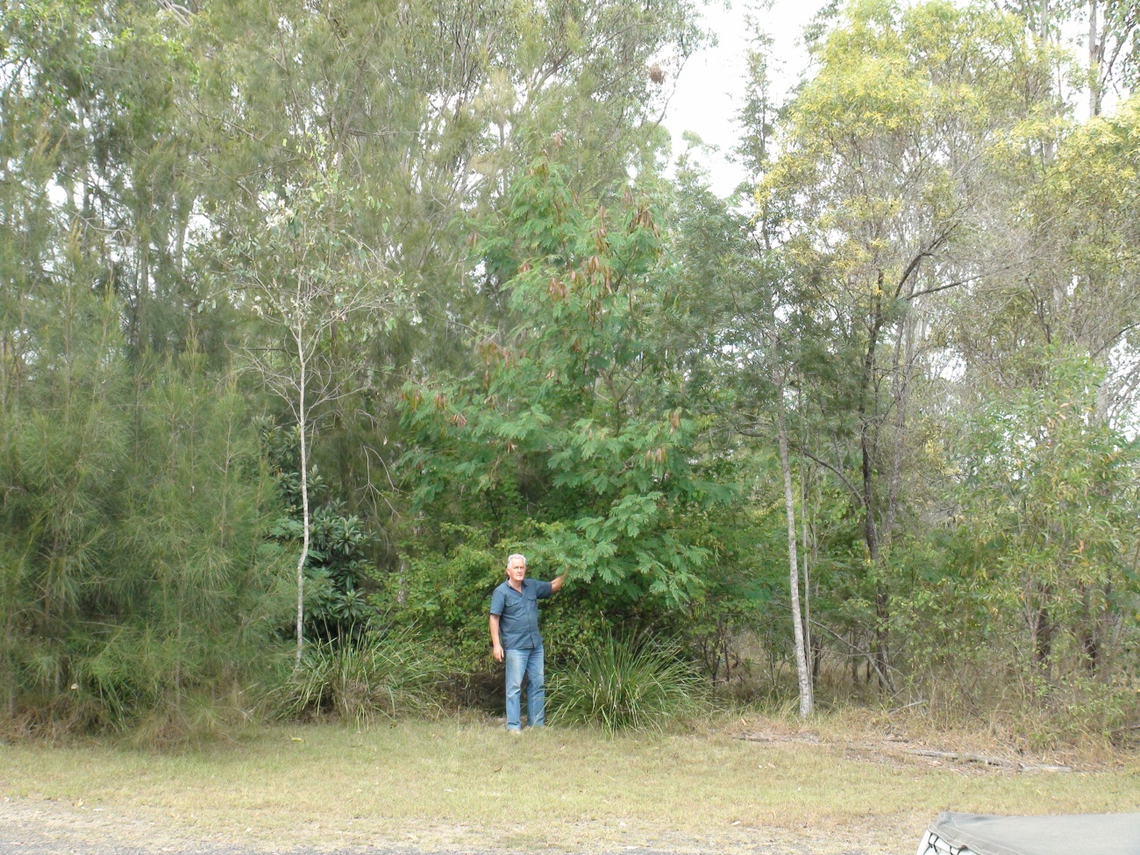
www.leucaena.net

Slide 53
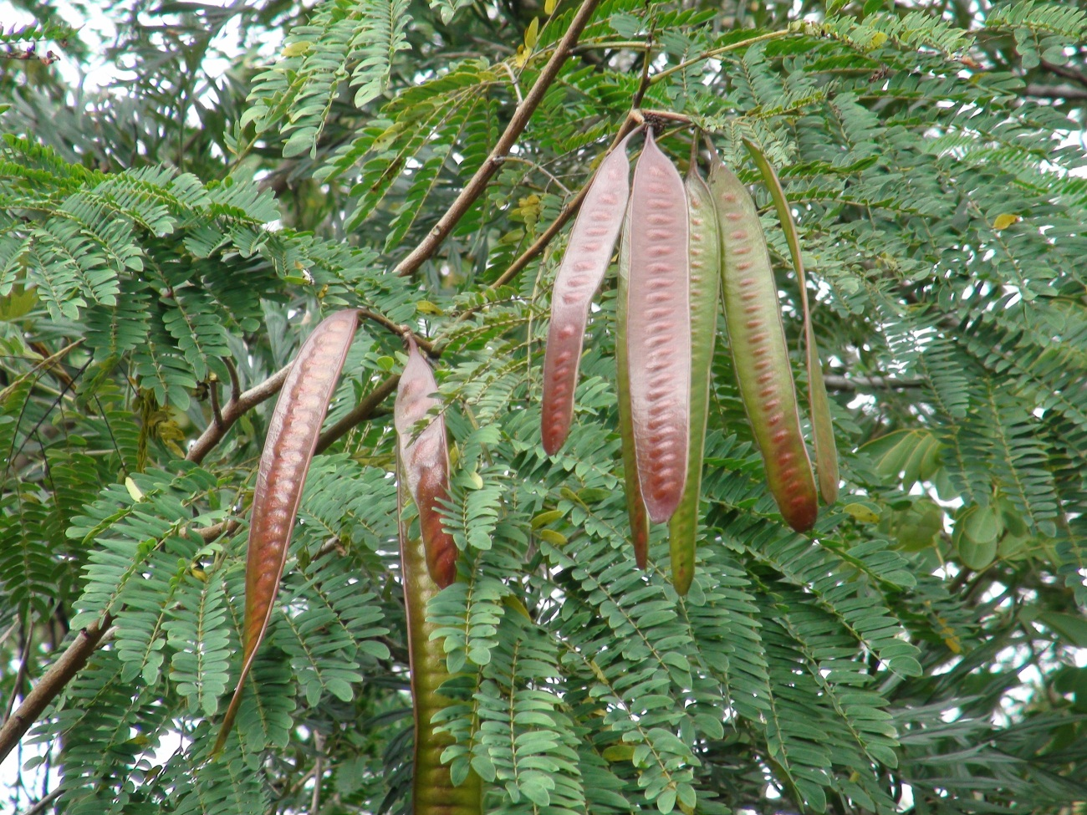

Slide 54
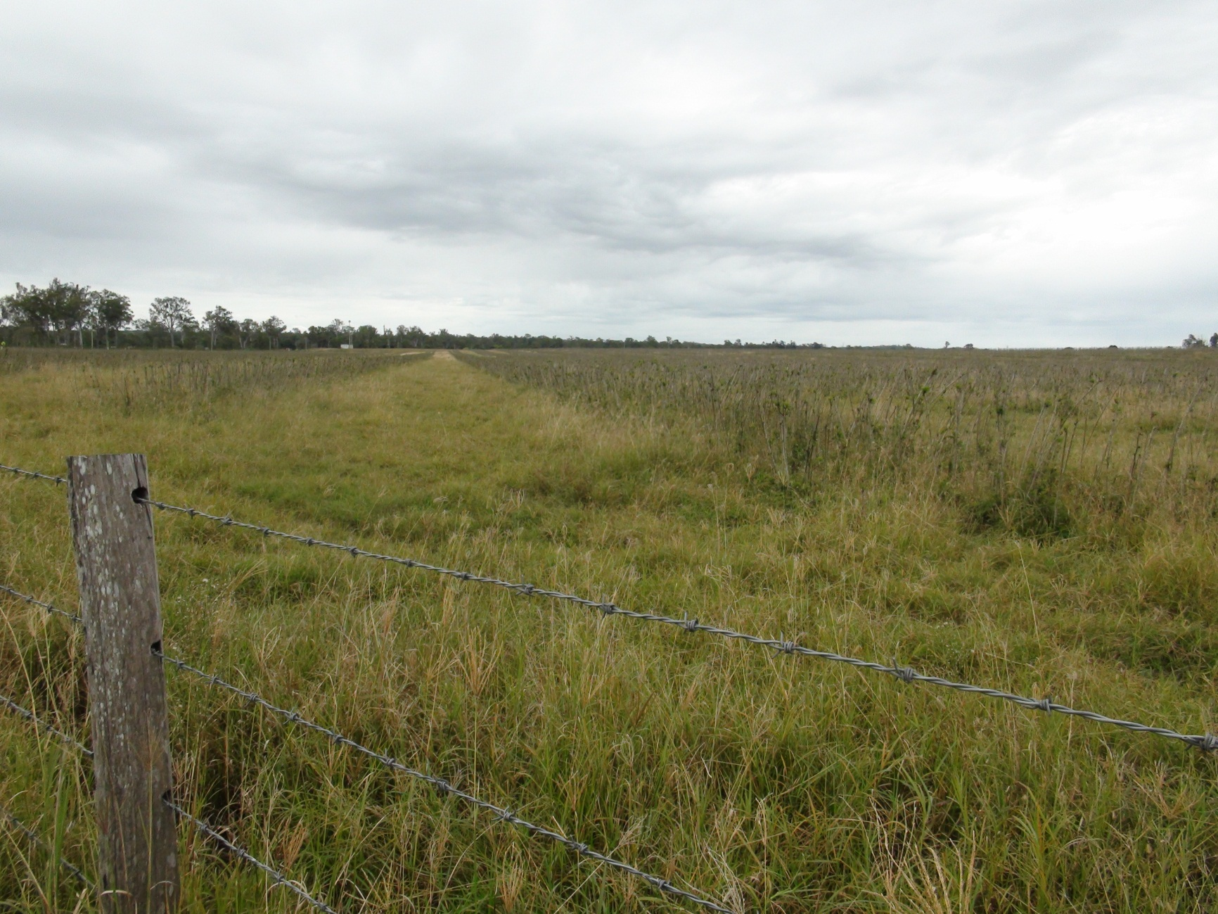
Strip farming 地带耕作

Slide 55
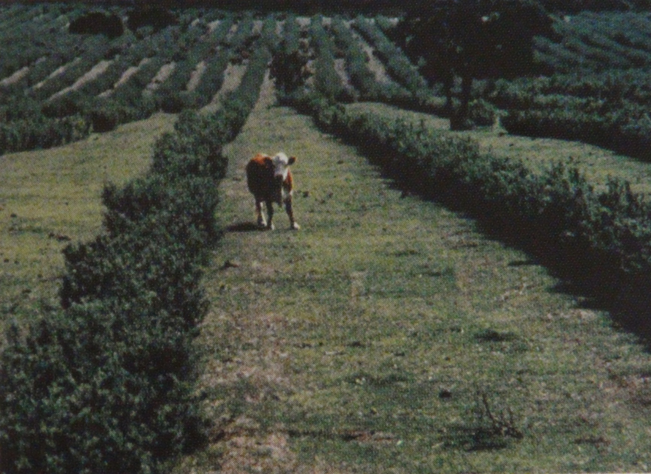

Slide 56
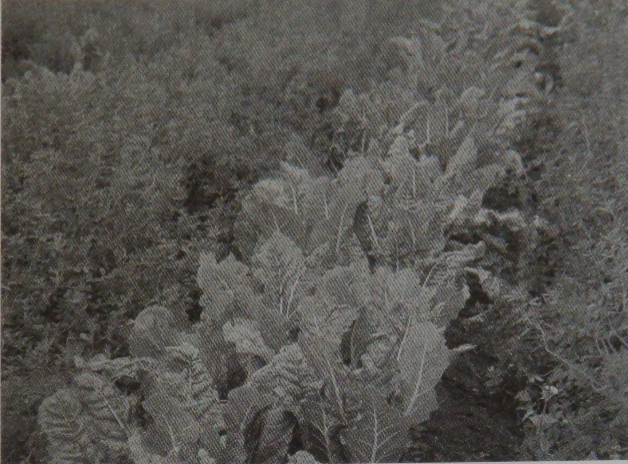

Slide 57
I have filled this furrow with prunings from Bolivian Beech, simply because it was available. I grew this trees from a cutting about 5 years ago.
我已经向这个沟，来自玻利维亚榉树的剪枝，只是因为它是可用的。从切割大约5年前，我长大此树。

Slide 58
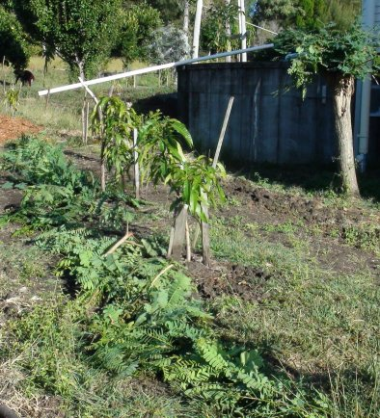

Slide 59
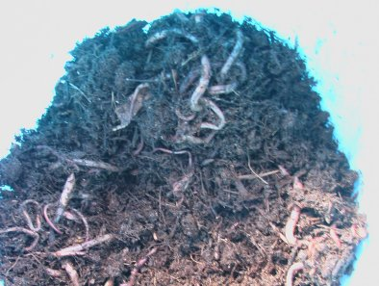
The furrows are soon filled with worms

Slide 60
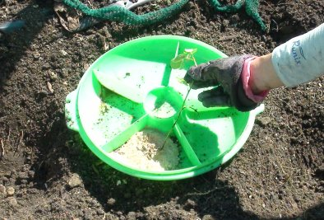
Dusting the roots with mycorrhizal fungi
喷粉与菌根真菌的根源

Slide 61
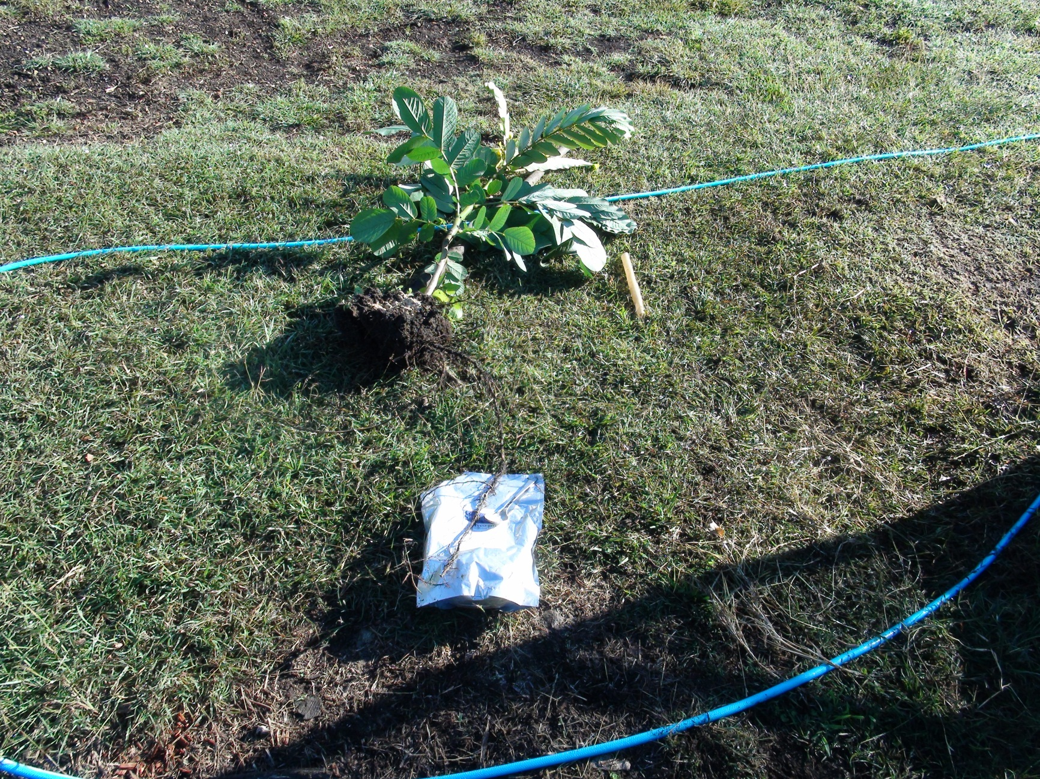
Sena alatus have very long roots covered with nodules for capturing nitrogen
塞纳箭羽有很长的根结节覆盖捕捉氮

Slide 62
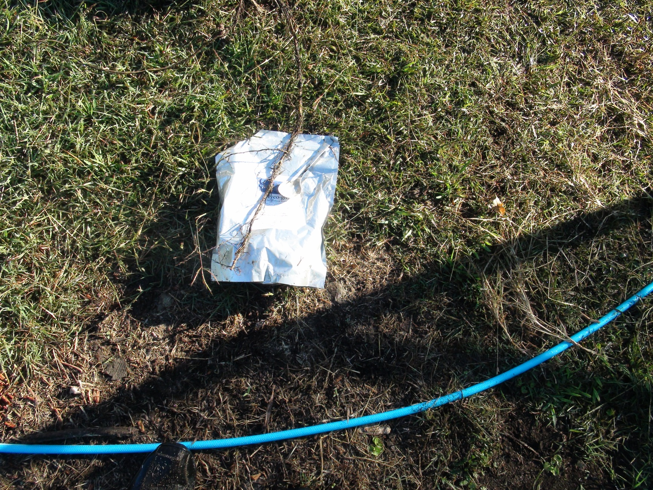

Slide 63
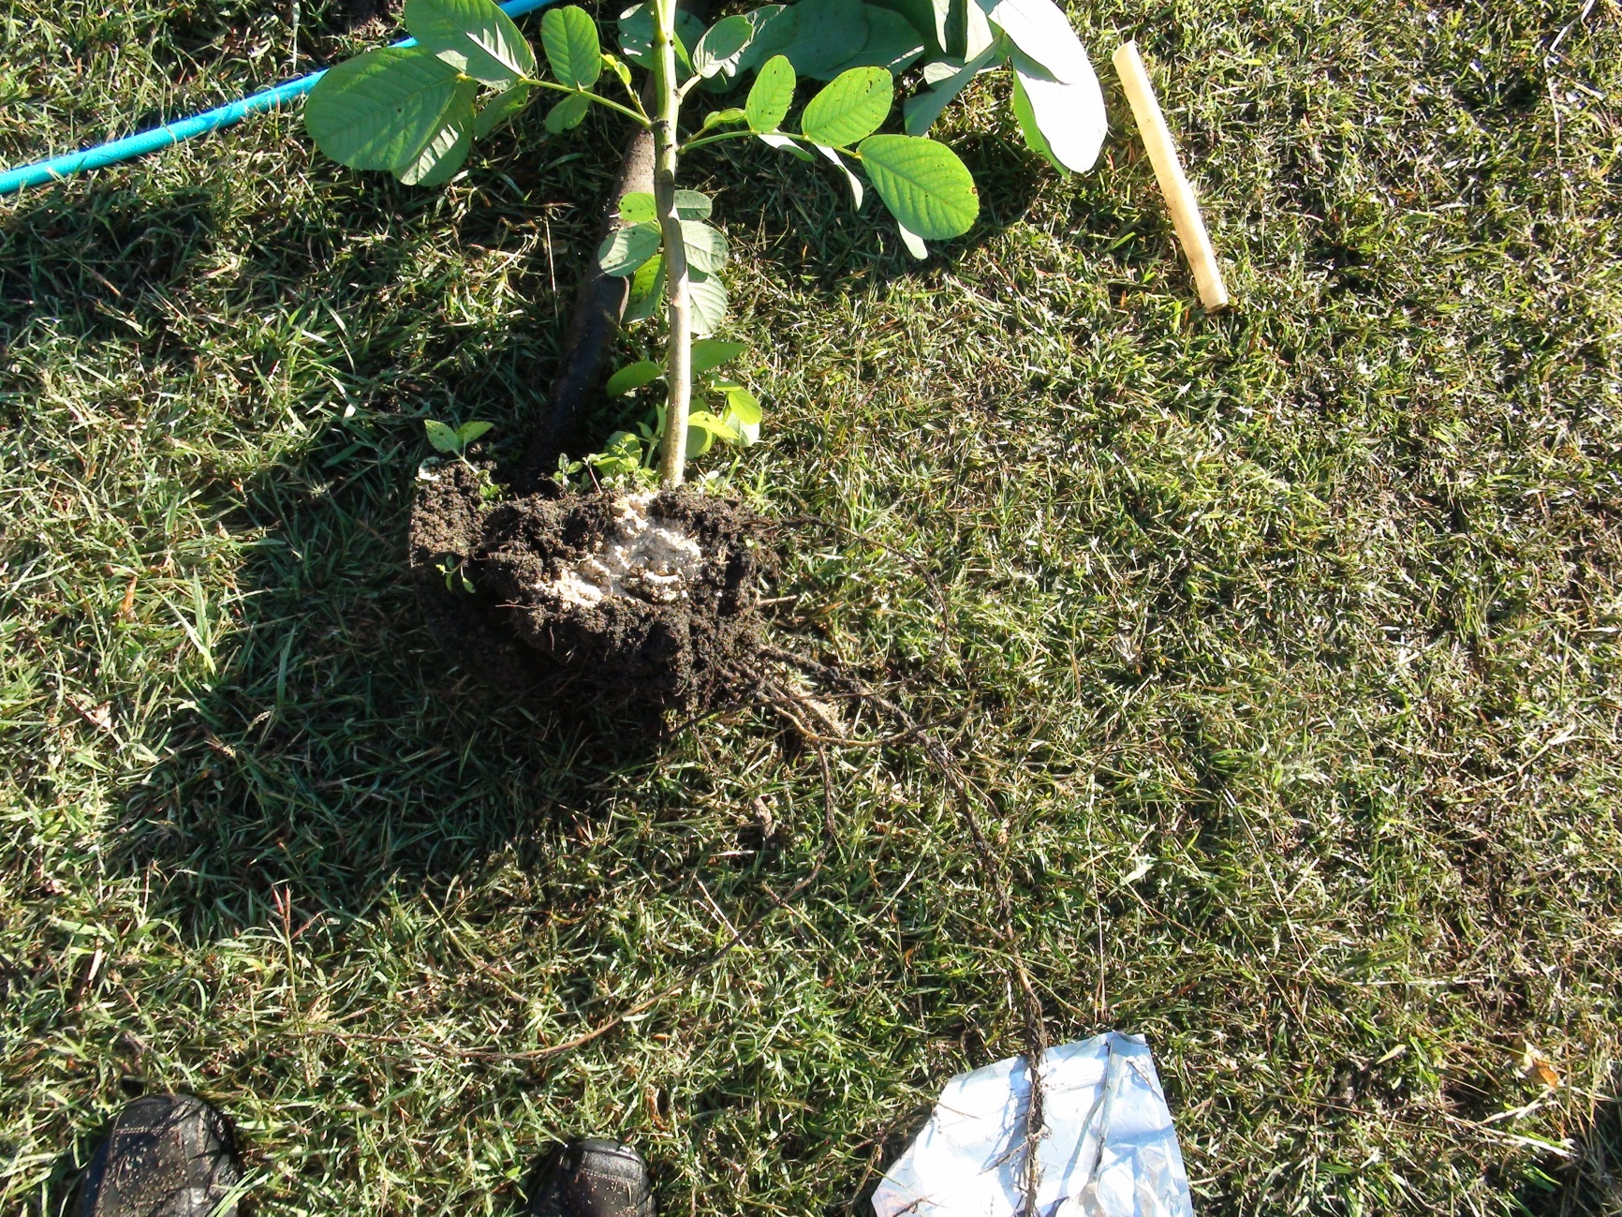

Slide 64
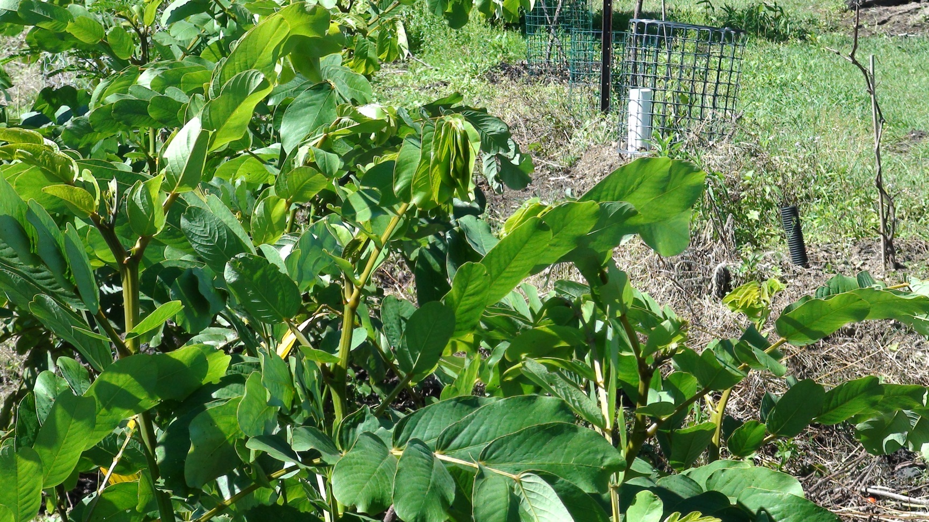
I am using sewage and waste water to grow sena alatus. They pick up the nutrients and grow very fast. The prunings are then used in the furrows, but the food crops never come into contact with the sewage. This may be a very good way of reusing sewage and waste water.
我使用的污水和废水，增长SENA箭羽。他们拿起的营养和生长速度非常快。的剪枝，然后用犁沟，但从来没有接触到污水粮食作物。这可能是一个很好的方式再利用的污水和废水。

